Slide 1
Live Smart
Hackathon
(Prototype)
Team: ree-Cloud
Notes:
You have proposed a lot of services to implement in your solution, and it is very structured by process.
Please elaborate further in your next presentation on how you will be using Sagemaker to determine what is approved or rejected, and what kind of information you will be filtering.
Prepare a 15 mins presentation to demonstrate your prototype and to update us on your progress on 27

Slide 2
CONTENTS
2. Process Flow + Demonstration
1. Summary
03
Recap of our solution
Recap of our Architecture
Explanation of each section w/ wireframe Screenshots
Request
Prototype demo
Review
Refund/Reply
Record

Slide 3


SUMMARY
Our Solution
A serverless web app with a dashboard for visibility into the cases and their statuses.
Ability to upload scanned documents that were submitted by customers
Uses an AWS Service(Sagemaker) to help give a confidence level for a approval

Slide 4

02 :
Main Process Flow
Shows the process of the main feature in our solution

Slide 5
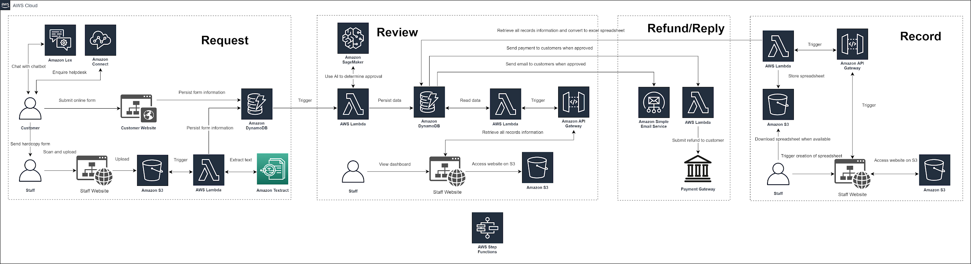
Recap
Higher resolution diagram: https://tinyurl.com/acraarc
Notes:
Request:
Hard Copy Form
Customer submits hard copy form to ACRA staff
Staff scans and uploads the document to the staff website where it will be stored in AWS S3
The uploading of the document to S3 triggers AWS Lambda and AWS Textract to extract text elements from the document and stores this information in AWS DynamoDB
Online Form
Customer submits online form on the customer website
Form details are stored in Amazon DynamoDB
Helpdesk and Chatbot
Customer can chat with chatbot which utilises AWS Lex
Customer can make enquiries to the helpdesk through AWS Connect
Review:
Decision Making Engine:
Once form details are added to AWS DynamoDB, AWS Lambda is automatically triggered where it will make use of Amazon SageMaker to determine if the case should be approved.
Dashboard:
The staff views the staff website which is hosted on AWS S3
The website makes use of Amazon API Gateway and AWS Lambda to retrieve the case records from AWS DynamoDB
Case status can be viewed (on-going and closed)
Refund/Reply:
Customer Notification:
When a case if approved or rejected, customers will be notified via email using AWS SES
Refund:
When a case is approved, AWS Lambda is triggered and submits a refund to the customer through the payment gateway
Record:
Excel Records:
Staff requests to view the excel spreadsheet.
This triggers Amazon API Gateway and AWS Lambda to retrieve records from AWS DynamoDB and export it as an excel spreadsheet
Spreadsheet is stored in AWS S3 where it can be downloaded

Slide 6
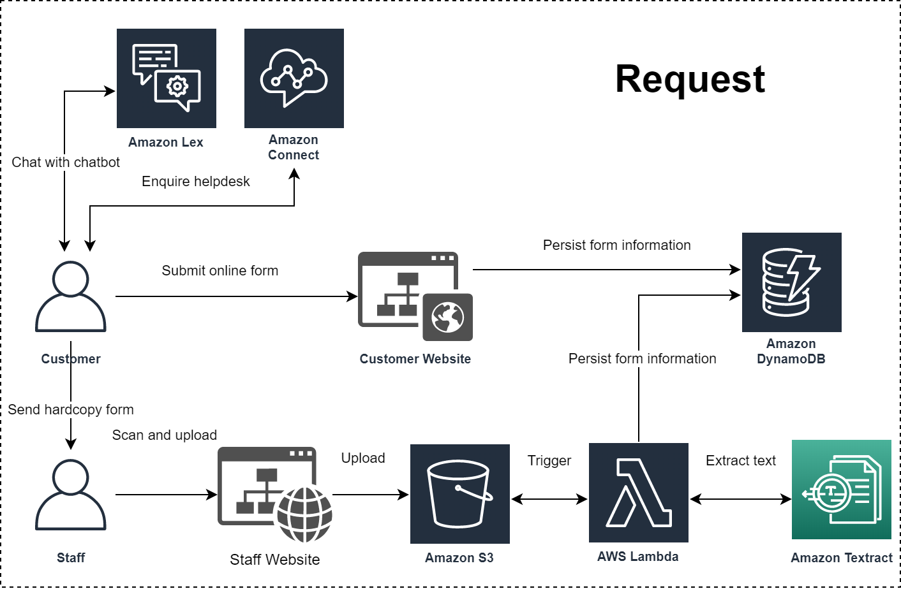
Request
Notes:
Request:
Hard Copy Form
Customer submits hard copy form to ACRA staff
Staff scans and uploads the document to the staff website where it will be stored in AWS S3
The uploading of the document to S3 triggers AWS Lambda and AWS Textract to extract text elements from the document and stores this information in AWS DynamoDB
Online Form
Customer submits online form on the customer website
Form details are stored in Amazon DynamoDB
Helpdesk and Chatbot
Customer can chat with chatbot which utilises AWS Lex
Customer can make enquiries to the helpdesk through AWS Connect

Slide 7
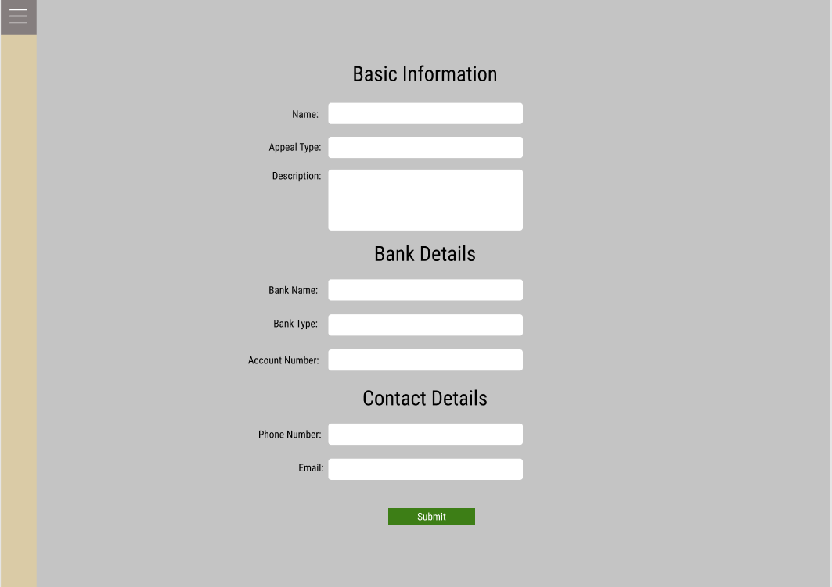
Request - Customer
Notes:
User can fill up form and submit

Slide 8
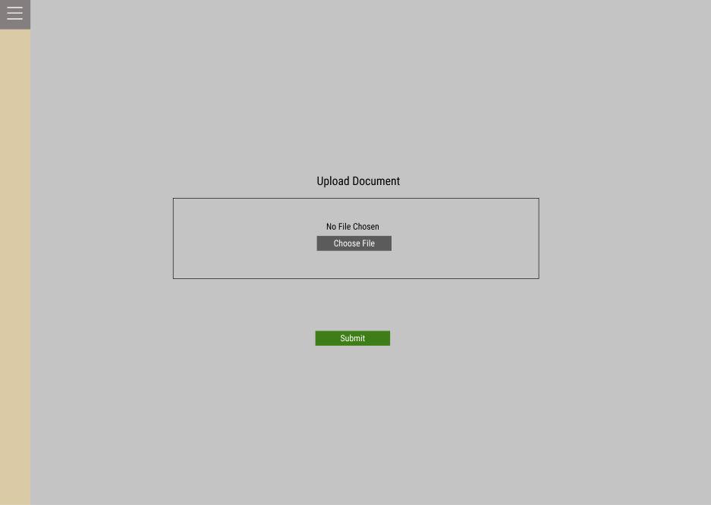
Request - Staff
Notes:
Staff upload document and submit

Slide 9
Textract
Demonstration
Notes:
Textract demonstration

Slide 10
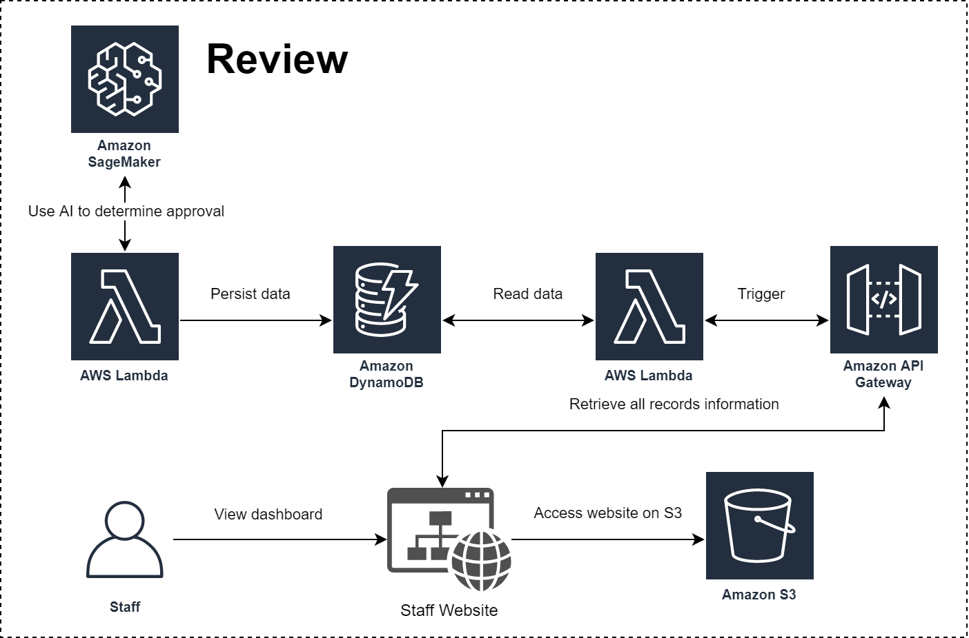
Review
Notes:
Review:
Decision Making Engine:
Once form details are added to AWS DynamoDB, AWS Lambda is automatically triggered where it will make use of Amazon SageMaker to determine if the case should be approved.
Dashboard:
The staff views the staff website which is hosted on AWS S3
The website makes use of Amazon API Gateway and AWS Lambda to retrieve the case records from AWS DynamoDB
Case status can be viewed (on-going and closed)

Slide 11
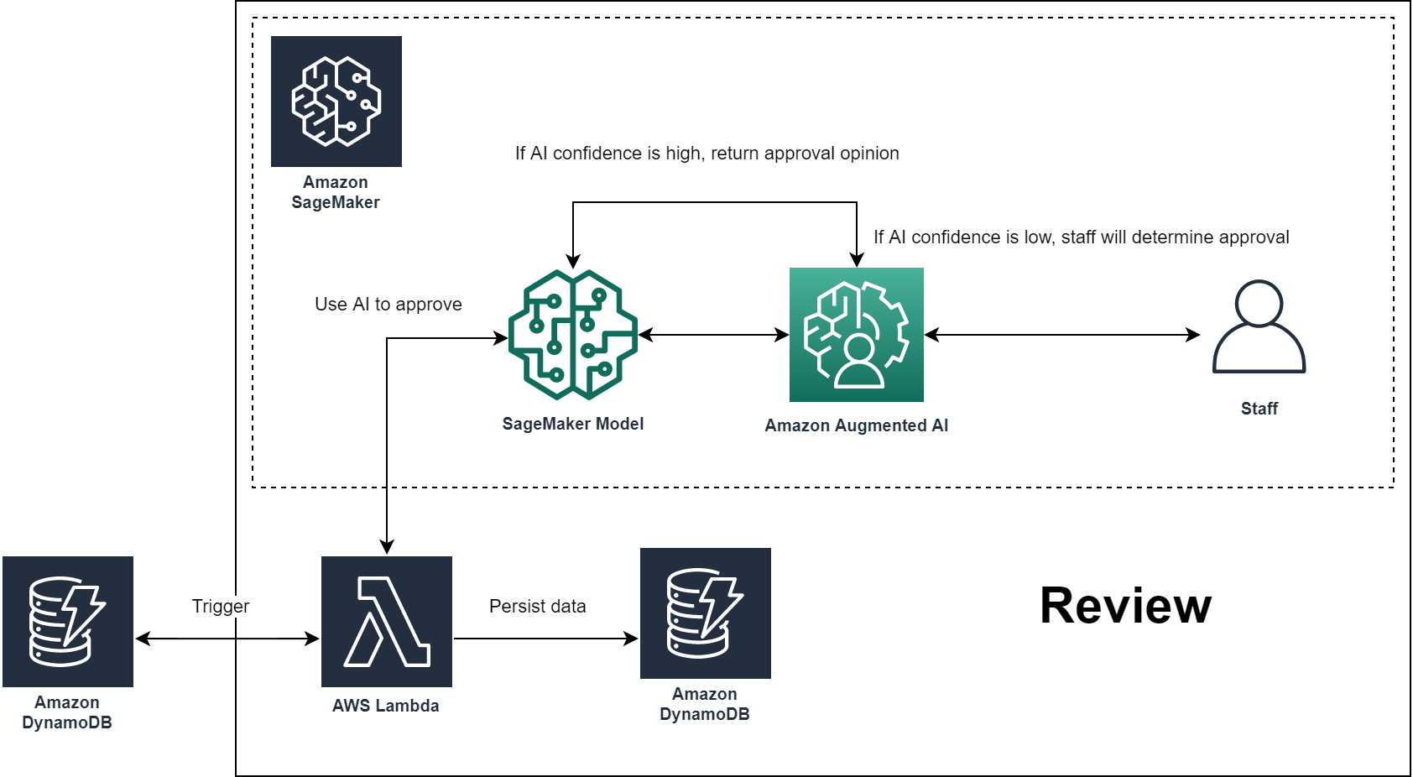
Main Process Flow
Notes:
Recap:
Decision Making Engine:
Once form details are added to AWS DynamoDB, AWS Lambda is automatically triggered where it will make use of Amazon SageMaker to determine if the case should be approved.
The flow:
Once Lambda is triggered, it uses the SageMaker model to conduct a confidence level check.
If the AI confidence is high:
it will return an approval opinion.
Else:
The staff will determine the approval
Details about Lambda:
The lambda interacts with the DynamoDB (blue dotted box) entries from the Request Process and reads it to SageMaker for processing. Lambda would also retrieve the processed entries and move them to DynamoDB (red dotted box) for persistent storage.
Details about SageMaker Model:
Sagemaker is used to determine if a case is to be approved or rejected (Rule engine)
The model we are looking into is a classifier model; To classify cases into two categories (Approve or Reject)
In addition, supervised learning will be used to train our ML model. For this, we made use of Augmented AI
Details about Augmented AI:
Augmented AI is used to review Machine Learning (ML) predictions to ensure that predictions are accurate

Slide 12
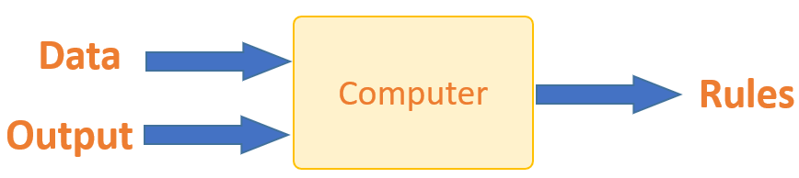

Main Process Flow
Notes:
Using the SageMaker:

Slide 13
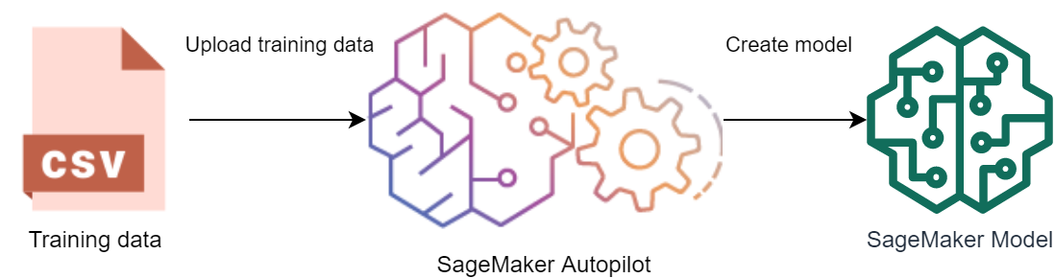
Main Process Flow
Notes:
Using the SageMaker Autopilot:
Auto/Binary classification

Slide 14
Main Process Flow
Notes:
Recap:
Decision Making Engine:
Once form details are added to AWS DynamoDB, AWS Lambda is automatically triggered where it will make use of Amazon SageMaker to determine if the case should be approved.
The flow:
Once Lambda is triggered, it uses the SageMaker model to conduct a confidence level check.
If the AI confidence is high:
it will return an approval opinion.
Else:
The staff will determine the approval
Details about Lambda:
The lambda interacts with the DynamoDB (blue dotted box) entries from the Request Process and reads it to SageMaker for processing. Lambda would also retrieve the processed entries and move them to DynamoDB (red dotted box) for persistent storage.
Details about SageMaker Model:
Sagemaker is used to determine if a case is to be approved or rejected (Rule engine)
The model we are looking into is a classifier model; To classify cases into two categories (Approve or Reject)
In addition, supervised learning will be used to train our ML model. For this, we made use of Augmented AI
Details about Augmented AI:
Augmented AI is used to review Machine Learning (ML) predictions to ensure that predictions are accurate

Slide 15
SageMaker
Demonstration
Notes:
Textract demonstration

Slide 16
Review
Notes:
Review:
Decision Making Engine:
Once form details are added to AWS DynamoDB, AWS Lambda is automatically triggered where it will make use of Amazon SageMaker to determine if the case should be approved.
Dashboard:
The staff views the staff website which is hosted on AWS S3
The website makes use of Amazon API Gateway and AWS Lambda to retrieve the case records from AWS DynamoDB
Case status can be viewed (on-going and closed)

Slide 17
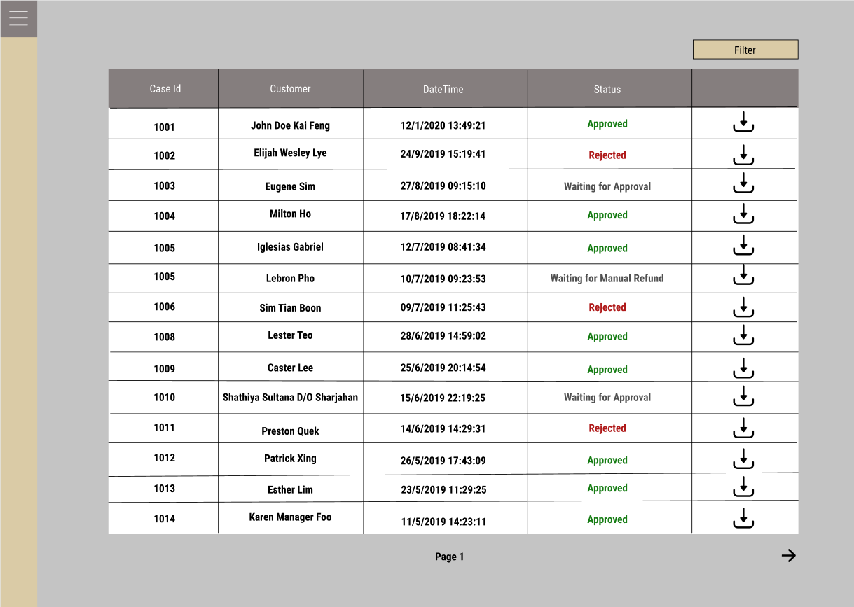
Review
Notes:
Staff can view statuses of cases (case id, date time, customer, status)
Status can be completed, rejected, waiting for approval, waiting for manual refund.
Staff can filter by status

Slide 18
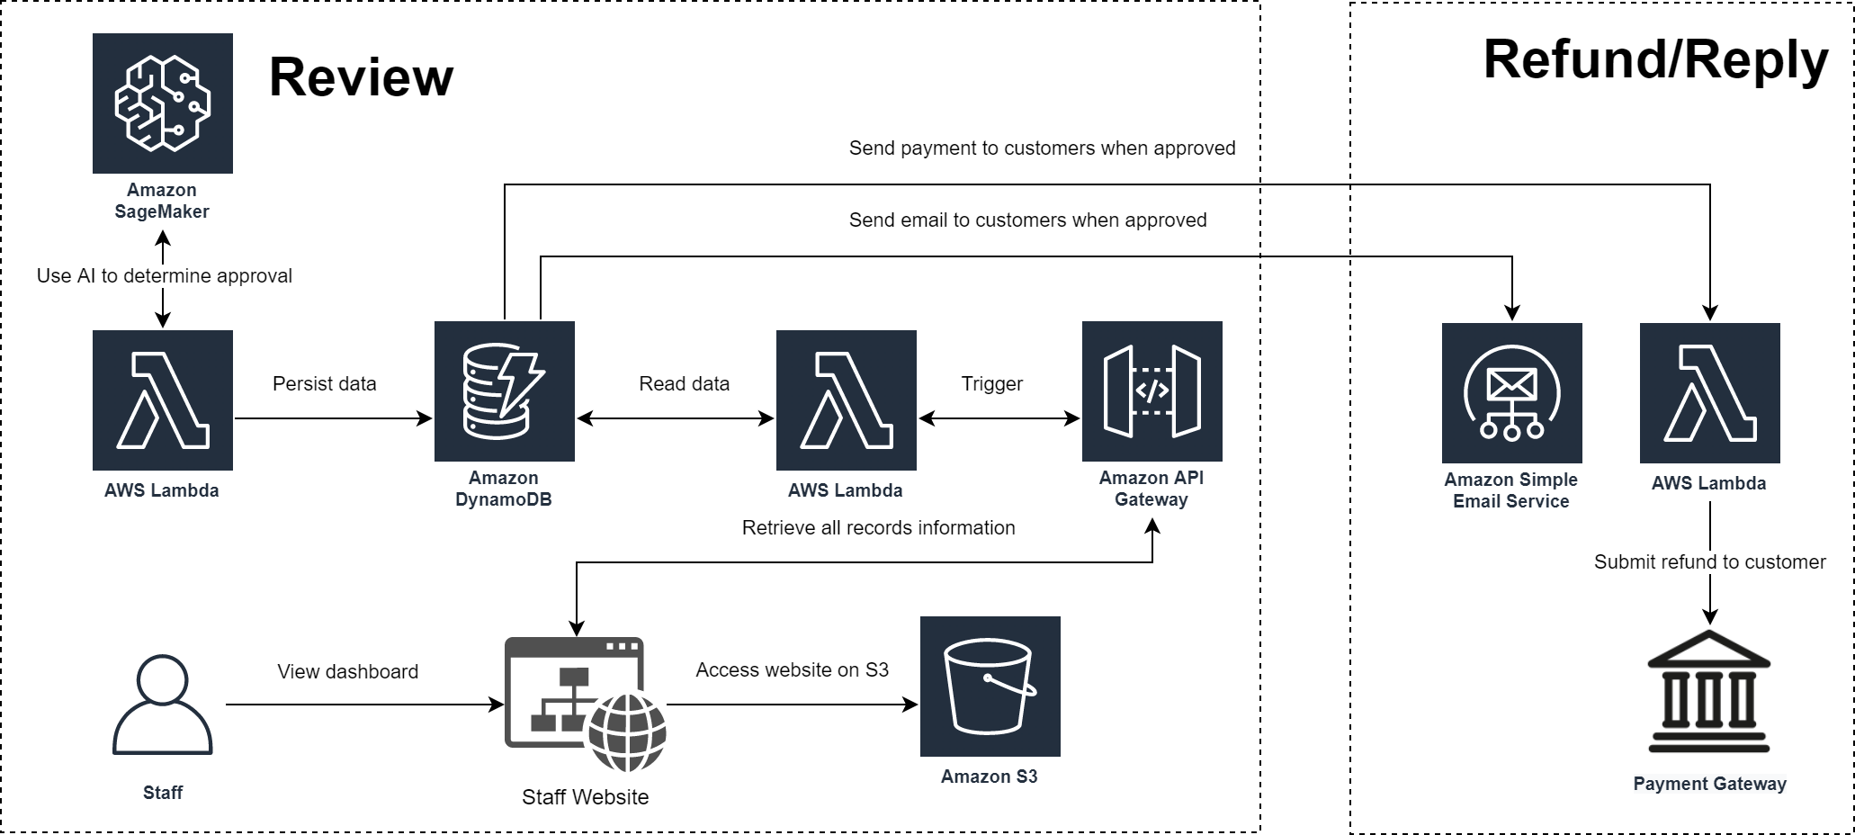
Refund/Reply
Notes:
Request:
Hard Copy Form
Customer submits hard copy form to ACRA staff
Staff scans and uploads the document to the staff website where it will be stored in AWS S3
The uploading of the document to S3 triggers AWS Lambda and AWS Textract to extract text elements from the document and stores this information in AWS DynamoDB
Online Form
Customer submits online form on the customer website
Form details are stored in Amazon DynamoDB
Helpdesk and Chatbot
Customer can chat with chatbot which utilises AWS Lex
Customer can make enquiries to the helpdesk through AWS Connect
Review:
Decision Making Engine:
Once form details are added to AWS DynamoDB, AWS Lambda is automatically triggered where it will make use of Amazon SageMaker to determine if the case should be approved.
Dashboard:
The staff views the staff website which is hosted on AWS S3
The website makes use of Amazon API Gateway and AWS Lambda to retrieve the case records from AWS DynamoDB
Case status can be viewed (on-going and closed)
Refund/Reply:
Customer Notification:
When a case if approved or rejected, customers will be notified via email using AWS SES
Refund:
When a case is approved, AWS Lambda is triggered and submits a refund to the customer through the payment gateway
Record:
Excel Records:
Staff requests to view the excel spreadsheet.
This triggers Amazon API Gateway and AWS Lambda to retrieve records from AWS DynamoDB and export it as an excel spreadsheet
Spreadsheet is stored in AWS S3 where it can be downloaded

Slide 19
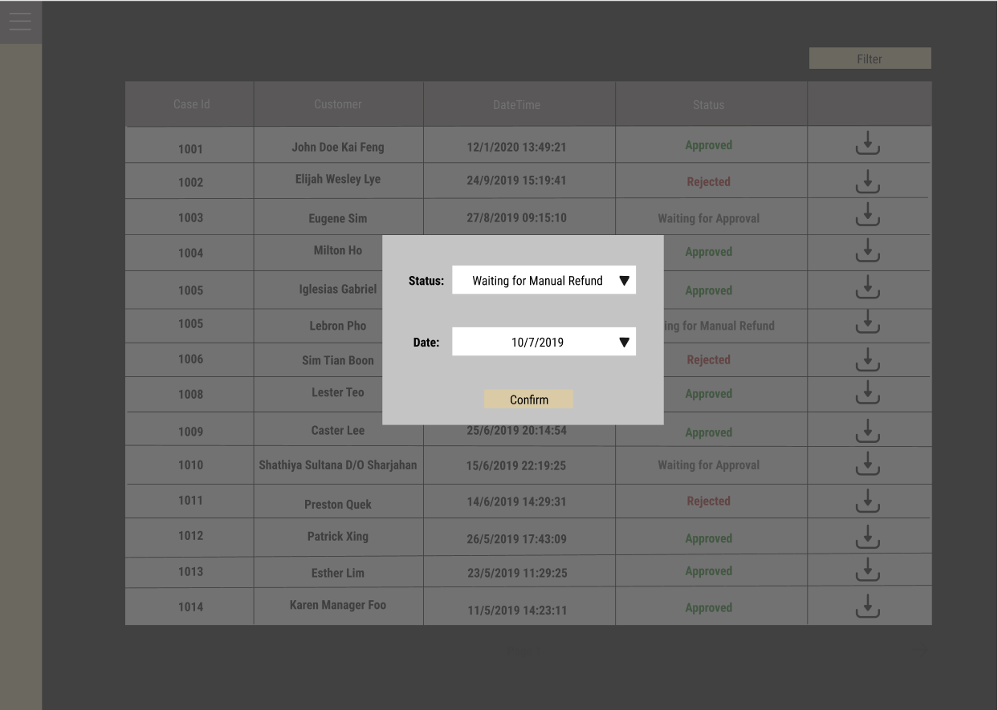
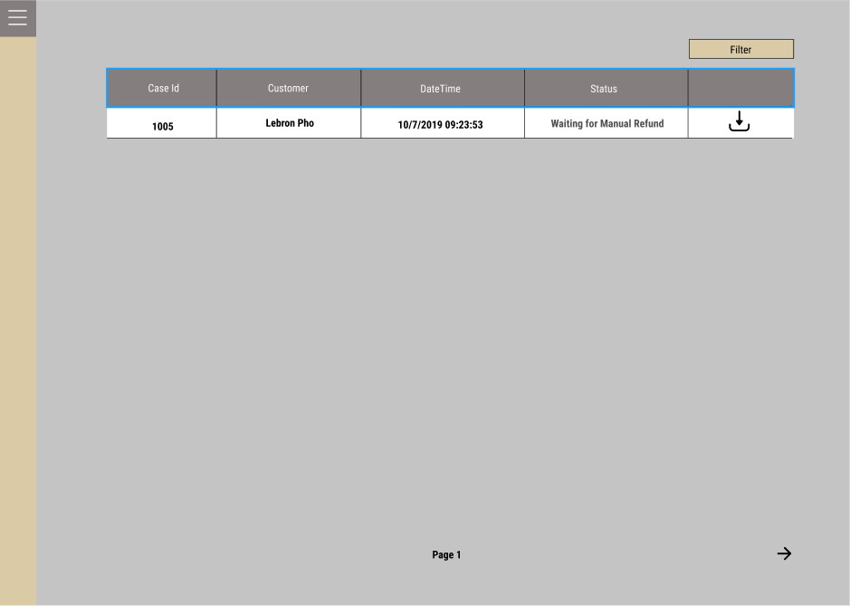
Refund/Reply
Notes:
Staff can see cases that require manual approval. Same view as review but show only filtered manual approval ones.

Slide 20
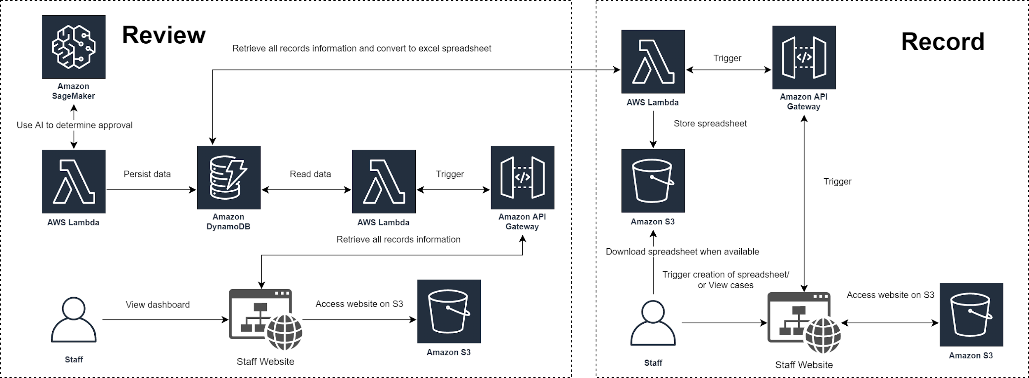
Record
Notes:
Request:
Hard Copy Form
Customer submits hard copy form to ACRA staff
Staff scans and uploads the document to the staff website where it will be stored in AWS S3
The uploading of the document to S3 triggers AWS Lambda and AWS Textract to extract text elements from the document and stores this information in AWS DynamoDB
Online Form
Customer submits online form on the customer website
Form details are stored in Amazon DynamoDB
Helpdesk and Chatbot
Customer can chat with chatbot which utilises AWS Lex
Customer can make enquiries to the helpdesk through AWS Connect
Review:
Decision Making Engine:
Once form details are added to AWS DynamoDB, AWS Lambda is automatically triggered where it will make use of Amazon SageMaker to determine if the case should be approved.
Dashboard:
The staff views the staff website which is hosted on AWS S3
The website makes use of Amazon API Gateway and AWS Lambda to retrieve the case records from AWS DynamoDB
Case status can be viewed (on-going and closed)
Refund/Reply:
Customer Notification:
When a case if approved or rejected, customers will be notified via email using AWS SES
Refund:
When a case is approved, AWS Lambda is triggered and submits a refund to the customer through the payment gateway
Record:
Excel Records:
Staff requests to view the excel spreadsheet.
This triggers Amazon API Gateway and AWS Lambda to retrieve records from AWS DynamoDB and export it as an excel spreadsheet
Spreadsheet is stored in AWS S3 where it can be downloaded

Slide 21
Record
Downloadable CSV file
Notes:
Staff can download an excel sheet of all the cases.

Slide 22
THANKS! QUESTIONS?

